Slide 1
Scaling
April 20, 2021

Slide 2
Scales in plant ecophysiology

Slide 3
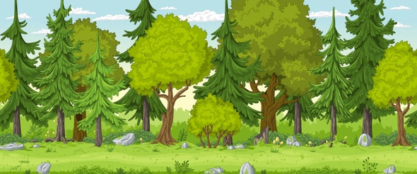
Primary two dimensions of scaling are temporal and spatial
Temporal
The timescale over which a driver or process of interest operates
Spatial
The area over which a driver or processes of interest operates

Slide 4
Primary two dimensions of scaling are temporal and spatial
Temporal
The timescale over which a driver or process of interest operates
Spatial
The area over which a driver or processes of interest operates

Slide 5
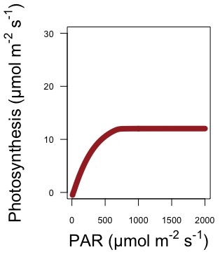
m = meters (single leaf), s = second

Slide 6
m = meters (single leaf), s = second

Slide 7
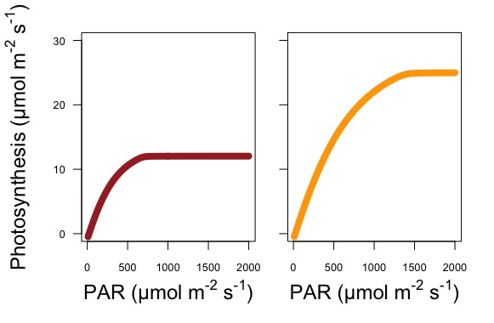
Low light acclimated
High light acclimated
m = meters (single leaf), s = second

Slide 8
Primary two dimensions of scaling are temporal and spatial
Temporal
The timescale over which a driver or process of interest operates
Spatial
The area over which a driver or processes of interest operates

Slide 9
Low light acclimated
High light acclimated
m = meters (single leaf), s = second

Slide 10
What is the spatial scale?
Is it different between panels?
Low light acclimated
High light acclimated
m = meters (single leaf), s = second

Slide 11
Low light acclimated
High light acclimated
m = meters (single leaf), s = second

Slide 12
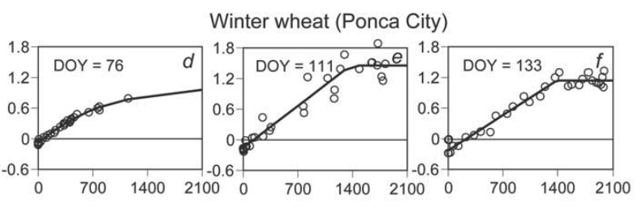
Example: what is the spatial and temporal scale(s)?
GPP (mg CO₂ m⁻² s⁻¹)
Light (µmol m⁻² s⁻¹)
m = meters (ground), s = second

Slide 13
The importance of scaling: an example exercise

Slide 14
Going up 5 ppm / year

Slide 15
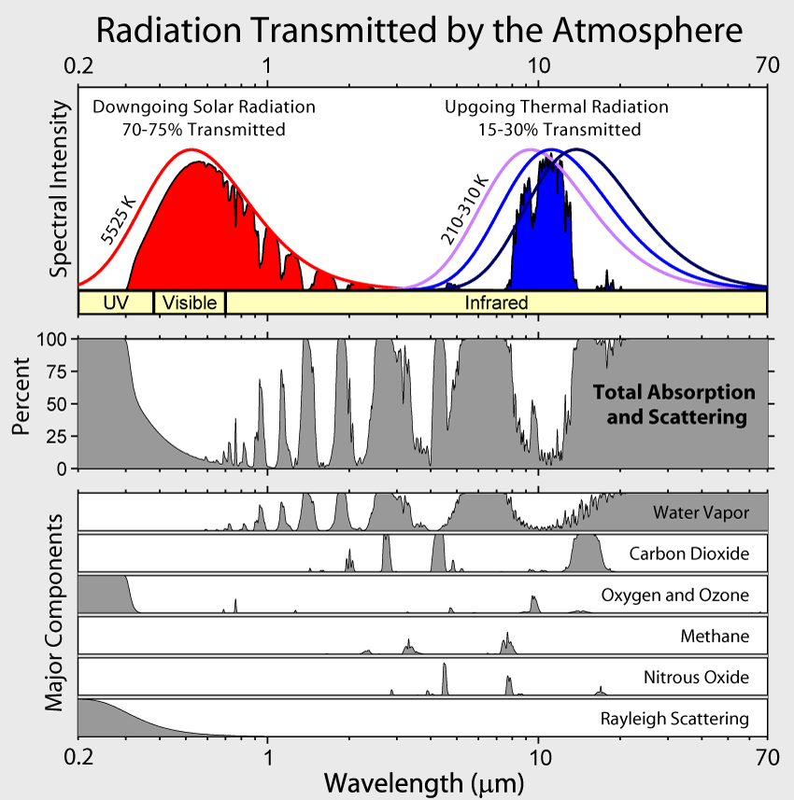

Slide 16
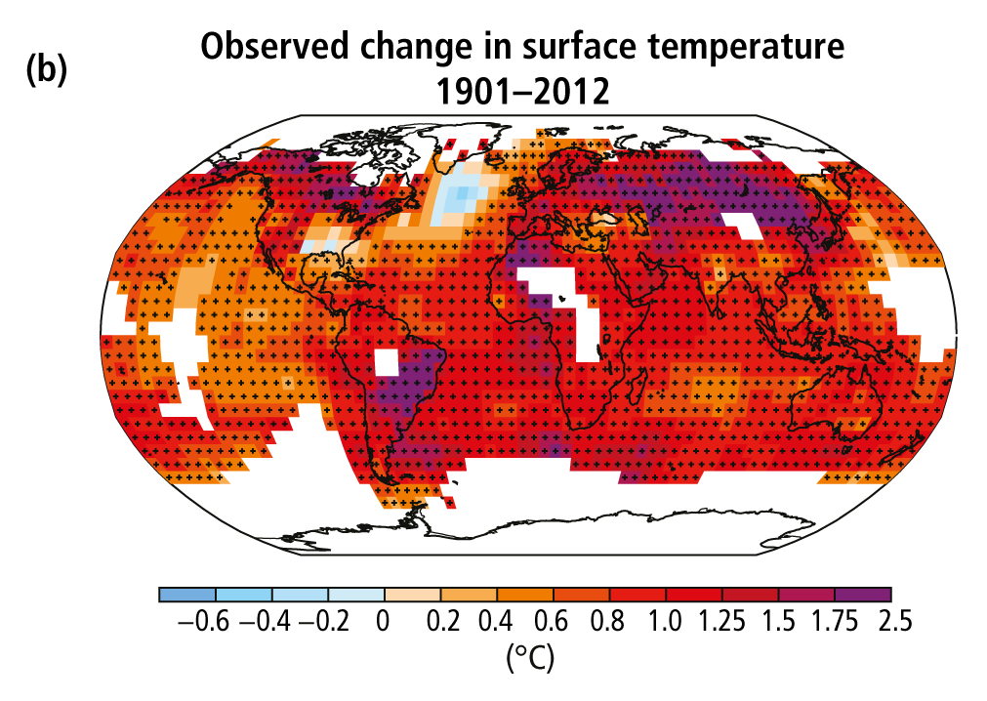
The climate is warming
Poles and land are warming the fastest
IPCC (2013)

Slide 17
O
C
O
Climate

Slide 18
O
C
O
Climate
Ecosystem
Services

Slide 19
O
C
O
Plants
Climate
Ecosystem
Services

Slide 20
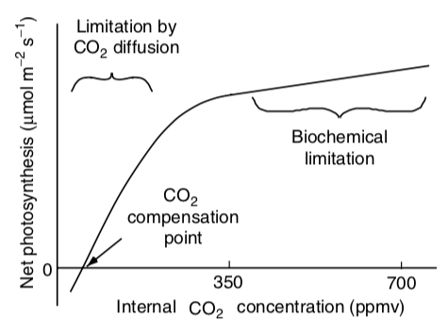

Slide 21
O
C
O
Plants
Climate
Ecosystem
Services

Slide 23
O
C
O
Plants
Climate
Ecosystem
Services

Slide 24
O
C
O
We’ve got this, right???
Plants
Climate
Ecosystem
Services

Slide 25
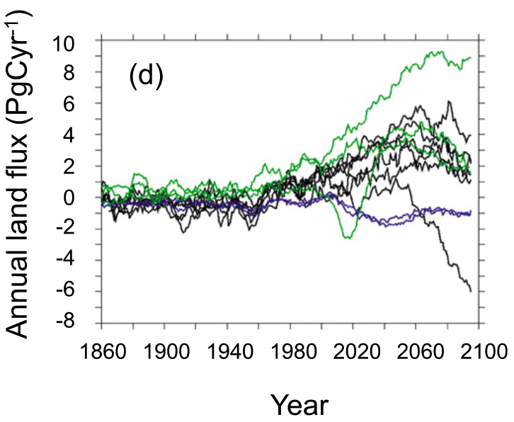
The direction and magnitude of the future land carbon sink is not known
Friedlingstein et al. (2014)

Slide 26
Land carbon sink correlates well with photosynthesis on land (r² > 0.9)
Friedlingstein et al. (2014)

Slide 27
Class activity
In teams of three, answer the following question: If photosynthesis drives the land carbon sink strength and temperature and CO₂ responses of photosynthesis are well characterized, why is the future carbon sink so uncertain?
Hint: this is a scaling issue
Friedlingstein et al. (2014)

Slide 28
Working across scales: measurements

Slide 29
Scale tradeoff
Mechanisms are easier to characterize at smaller scales
As you increase scale, the details become less clear
Outcomes are easier to characterize at larger scales
As you reduce scale, it is difficult to understand all the interactions that might influence a process

Slide 30
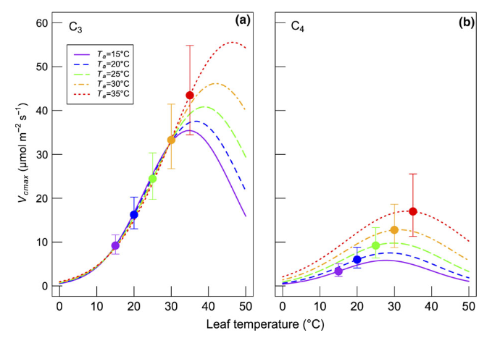
Ecophysiological scale consideration 1: controlled versus uncontrolled conditions
Controlled environment
Pro: can measure ecophysiological process response while holding all conditions constant
Smith and Dukes (2017)

Slide 31
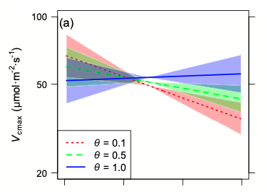
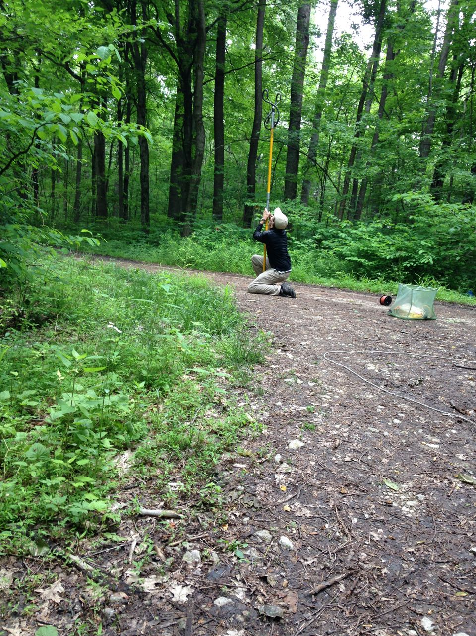

Ecophysiological scale consideration 1: controlled versus uncontrolled conditions
Controlled environment
Con: might miss important interactions, environment not in-tact
Smith and Dukes (2018)

Slide 32
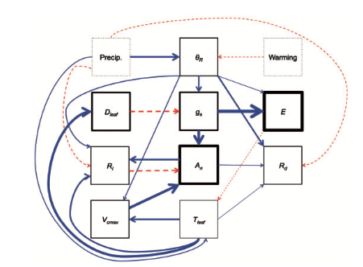
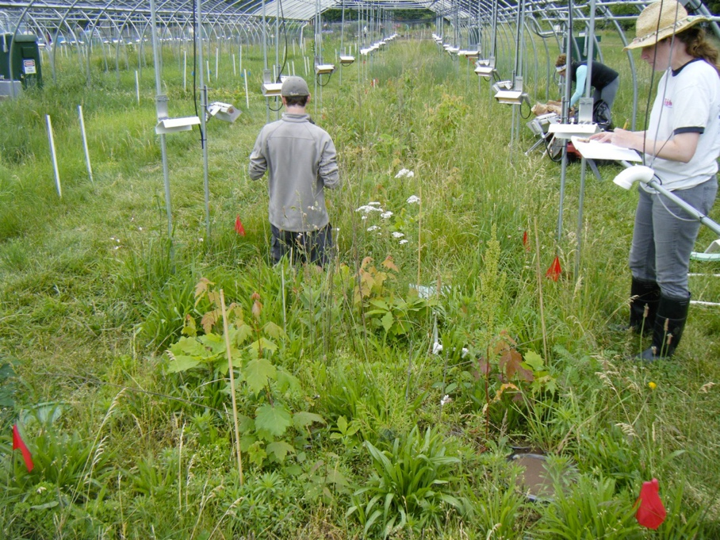
Ecophysiological scale consideration 1: controlled versus uncontrolled conditions
Middle ground: field manipulations
Pro: can manipulate in-tact environment
Con: still not truly “natural” (and expensive)
Smith et al. (2016)

Slide 33
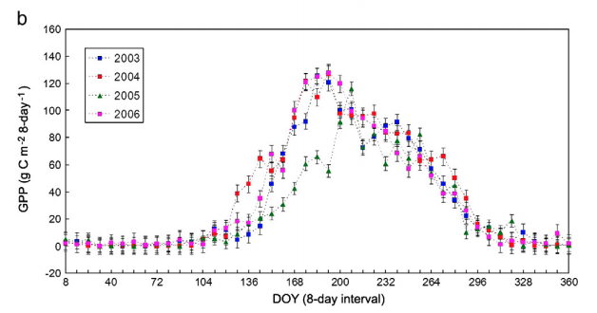
Ecophysiological scale consideration 2: organ versus ecosystem
Ecosystem-scale measurements
Pro: measure the impact on more important scale
Wu et al. (2010)

Slide 34
Ecophysiological scale consideration 2: organ versus ecosystem
Ecosystem-scale measurements
Pro: measure the impact on more important scale; lots of options

Slide 35
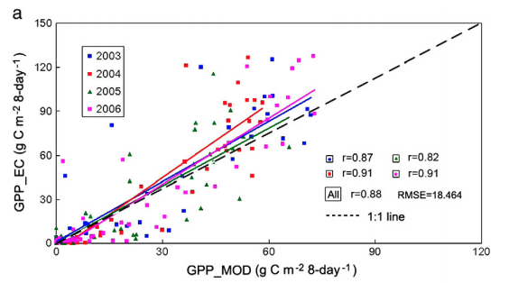
Ecophysiological scale consideration 2: organ versus ecosystem
Ecosystem-scale measurements
Con: not a direct measurement; some disagreement
Wu et al. (2010)

Slide 36
Working across scales: modeling

Slide 37
Models provide a way to assess the scalability of mechanisms (example with photosynthetic acclimation)

Slide 38
Models provide a way to assess the scalability of mechanisms
Steps involved
Evaluate process mechanisms under highly controlled conditions (small scale)

Slide 39
Smith and Dukes (2017)

Slide 40
Models provide a way to assess the scalability of mechanisms
Steps involved
Evaluate process mechanisms under highly controlled conditions (small scale)
Develop a theory for process and it’s environmental response

Slide 41
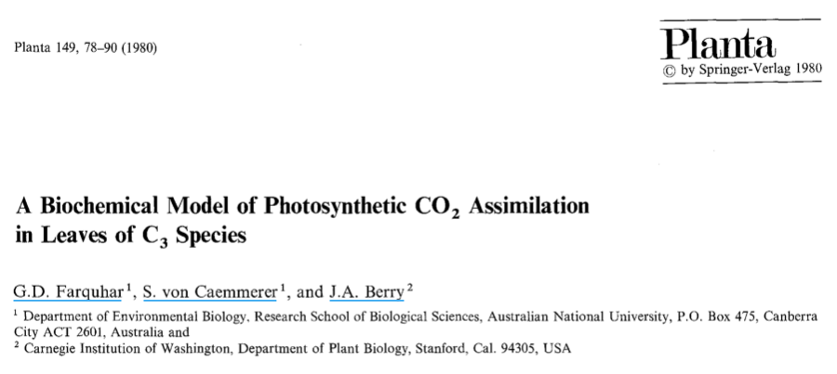
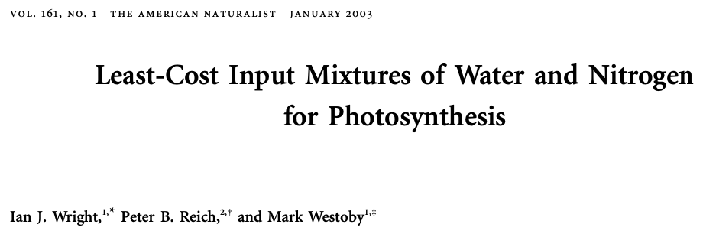

Slide 42
Models provide a way to assess the scalability of mechanisms
Steps involved
Evaluate process mechanisms under highly controlled conditions (small scale)
Develop a theory for process and it’s environmental response
Quantify the theory and build a model

Slide 43
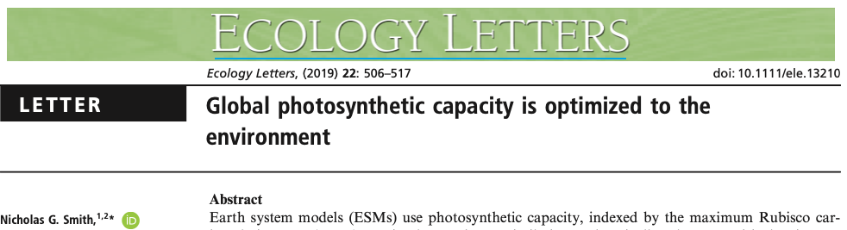
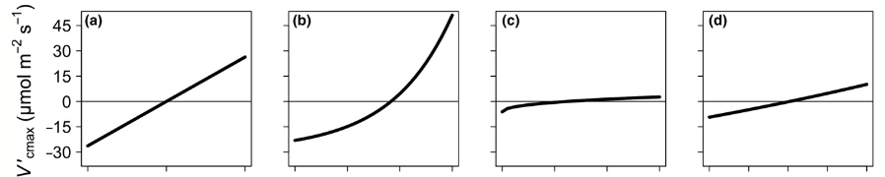

Slide 44
Models provide a way to assess the scalability of mechanisms
Steps involved
Evaluate process mechanisms under highly controlled conditions (small scale)
Develop a theory for process and it’s environmental response
Quantify the theory and build a model
Simulate similar or connected processes that can be measured at larger scales

Slide 45
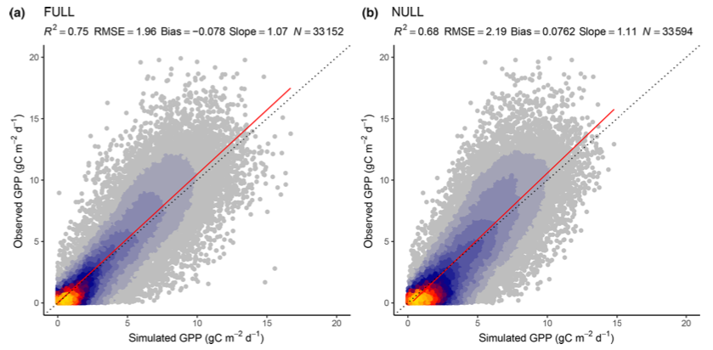
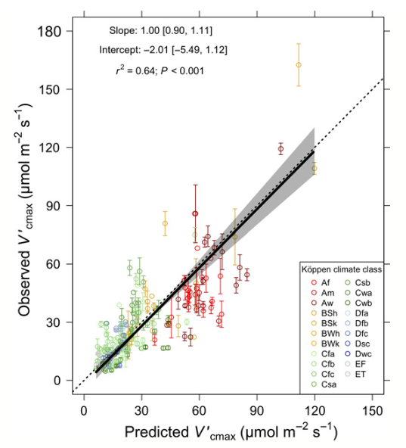
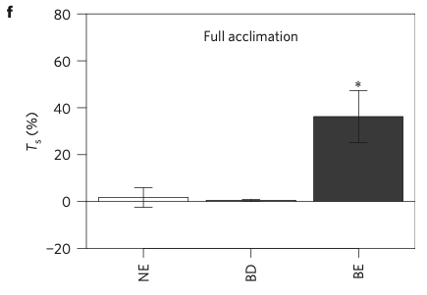
Stocker et al. (2020)
Smith et al. (2019)
Smith et al. (2016)

Slide 46
Improved scaling: coordinated research networks

Slide 47
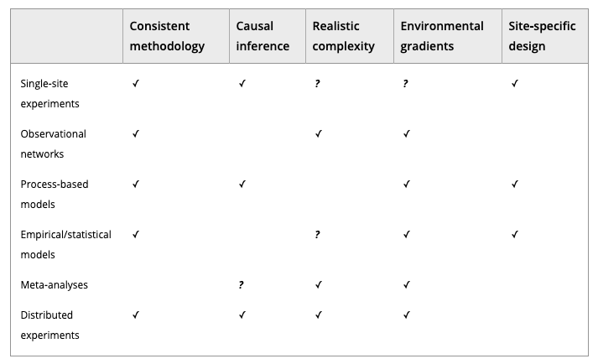
Borer et al. (2013) Meth. Ecol. Evo.

Slide 48
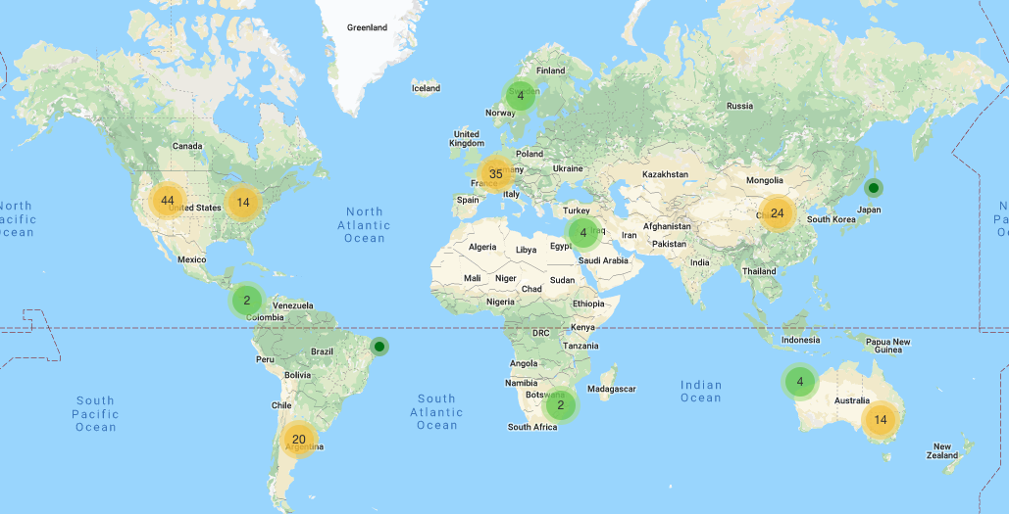
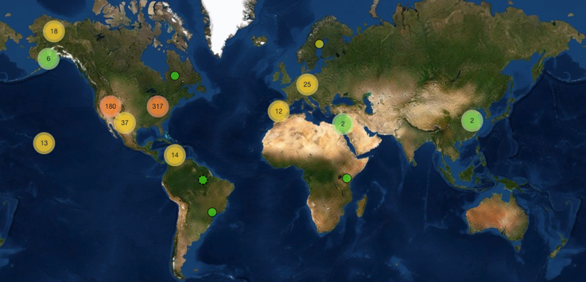
PhenoCam
Network

Slide 49
The National Ecological Observatory Network (NEON)

Slide 50
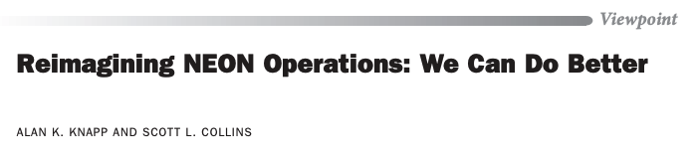
The National Ecological Observatory Network (NEON)
BioScience (October 2019)

Slide 51
Long-term ecological and agricultural research sites (LTER and LTAR)
**Measurements not coordinated**

Slide 52
Future predictions: realism versus reliability

Slide 53
Land surface models
UCAR

Slide 54
Earth System Models
Dr. Kaitlin Naughten

Slide 55
Future predictions: realism versus reliability

Slide 56
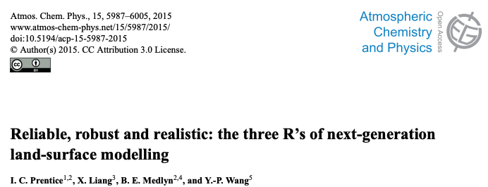
Adding processes to models may improve their realism…

Slide 57
…but may also make them more unreliable and uncertain

Slide 58
Literature review consideration: What scales are you evaluating?

